Slide 1
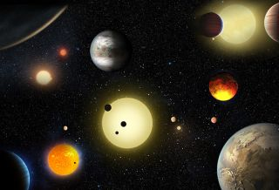
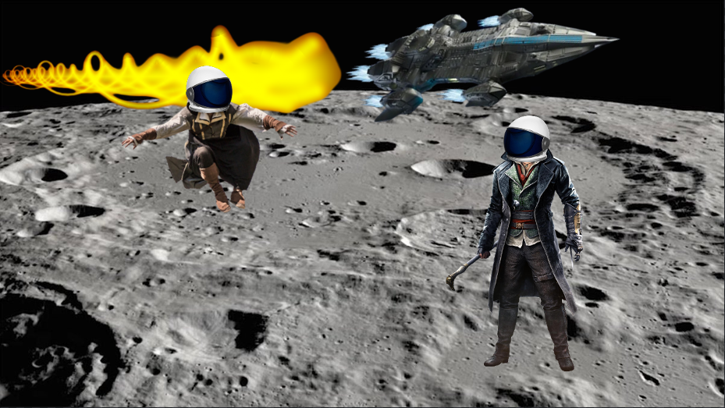
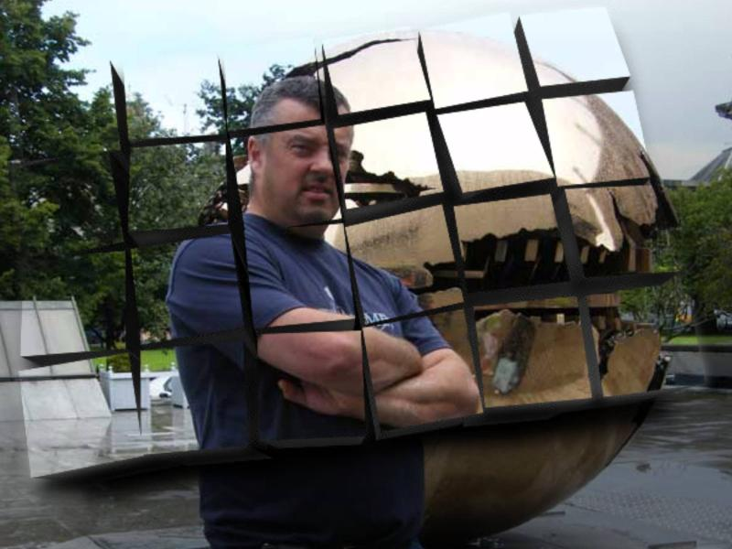
Feature points
An action rpg that is set in a wide environment in space.
Instead of fighting in older times on earth- we took the concept and adapted in to a space theme so our player can travel to different planets and assassinate different alien dictators and leaders in order to preserve peace.
There will be a focus on anti gravity parkour and free roaming through space and planets.

Slide 2


Market analysis
This game takes elements from popular games like previous Assassins creed games, the Witcher and a space elements similar to what is found in Destiny 2.
Our target audience would be teenagers 13+ and young adults, as they will have more freedom to purchase in game items in order to increase our sales profit, the environment is also exciting for this age range.
We expect this game to overtake every other Assassin Creed game as the element of space just improves a game tenfold.
Our Revenue is expected to be 3 billion as we will also introduce more micro transactions as well as having a price tag of $60.

